Slide 1
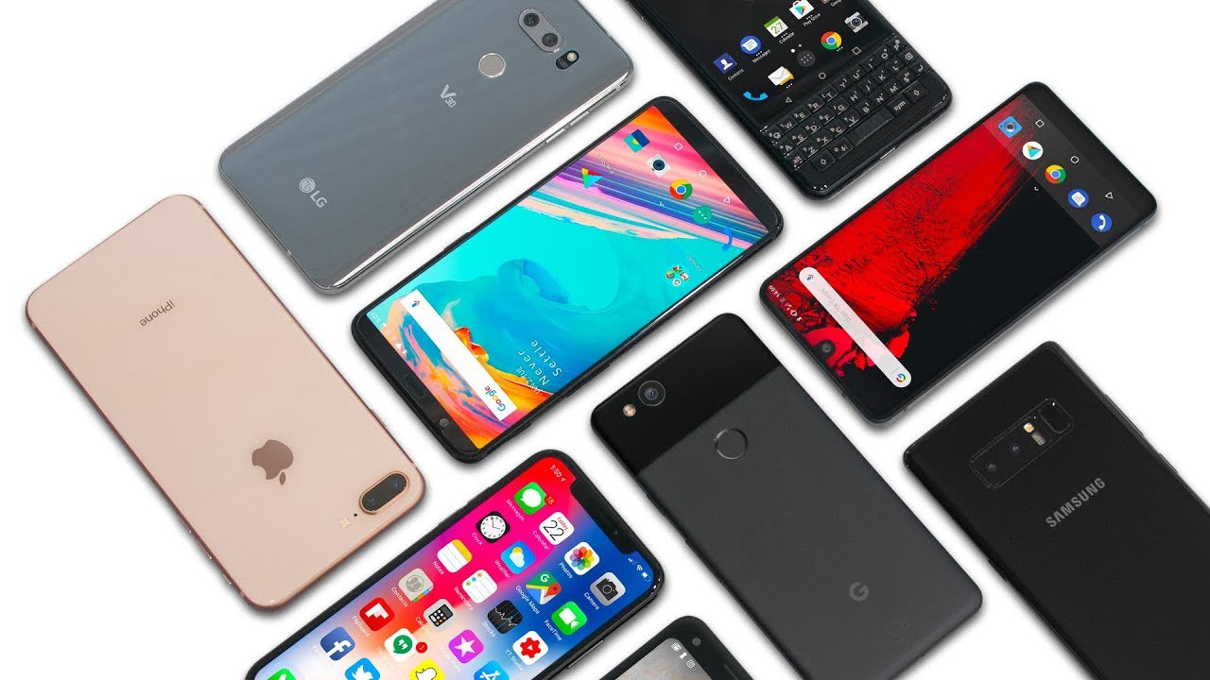

PF Project Presentation
Advance Search Engine For Mobile Products
[ Syed Aun Ali Zaidi (Group Leader) ] - [20K-0286]
[ Muhammad Anas ]-[20K-0179]
[ Ammar Amin ]-[20K-0285]

Slide 2

What does it really do?
The Software is basically a search engine for smartphones.
It takes the required inputs and filters out the smartphones which does not meet the required criteria and finally displays all of the smartphones which does meet the criteria.
Thus leaving the choice of choosing the desired product to the user.
It further allows the user to compare the desired product with other smartphone of their choice.
The software will finally display a passage in English comparing all the features of the chosen smartphones with each other.

Slide 3

What are its aims?
Smartphones these days are usually replace by a new one in a matter of weeks.
Via advance search, this program will aid the users to identify which mobile phone would best suit them judging from their input like camera, OS, Ram, memory and many more things.
Thus eliminating all sorts of risks relating to wrong product purchase and consequently aiding the user in deciding their final choice!
The ability to compare with other smartphones will further aid the user into selecting which product is better.
In conclusion, the software makes it way easier for the user to get most out of their expenditure.

Slide 4


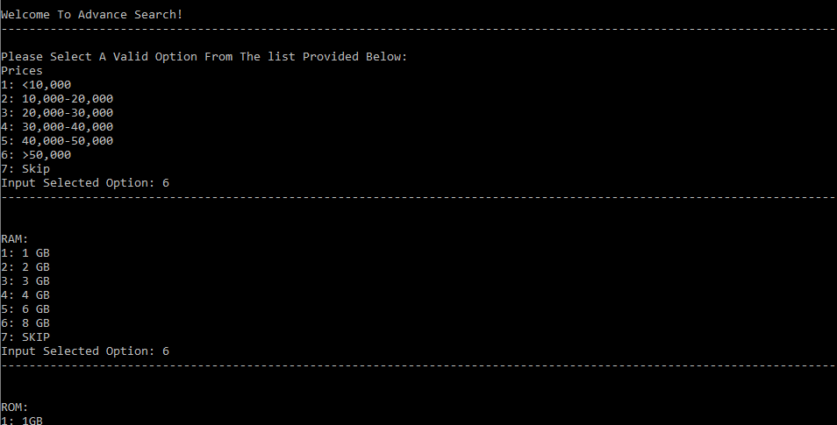
Input
User will be provided with a list of valid and relative options from which he/she can select the desired feature from e.g.:

Slide 5

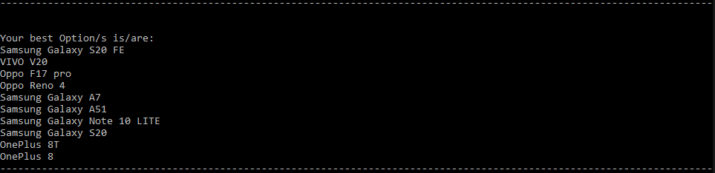
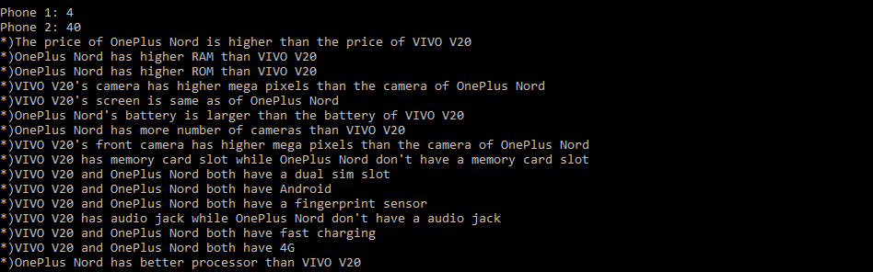
Output
After taking the input, the program will filter out the smartphones that does not meet the required criteria and finally outputs the name of the products that does meet the criteria!
Along with this, user will be provided with a choice to compare any two products of his/her choice, the program then will print a passage in English comparing the two products together.

Slide 6
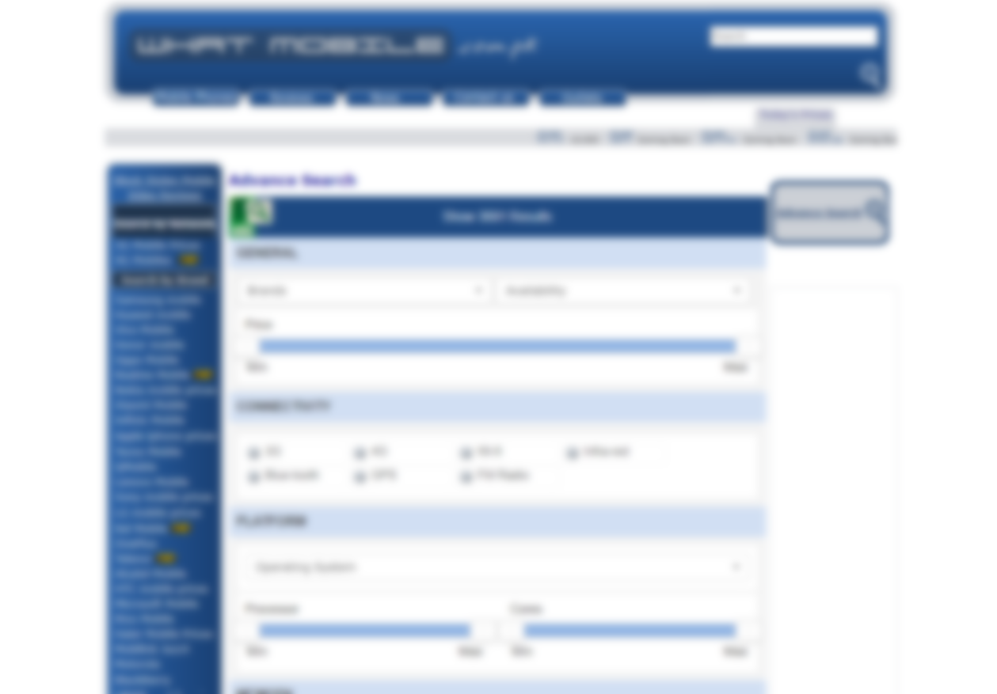
Influenced from…
The software is influenced from the advance search engine of whatmobile.com.
The software is the exact replica of the search engine with some more added features, like comparison between products, and achieves the same desired outputs by via giving the user a list of relative and valid options from which user can select the desired feature from.

Slide 7


Thank You For Your Time!

